Slide 1
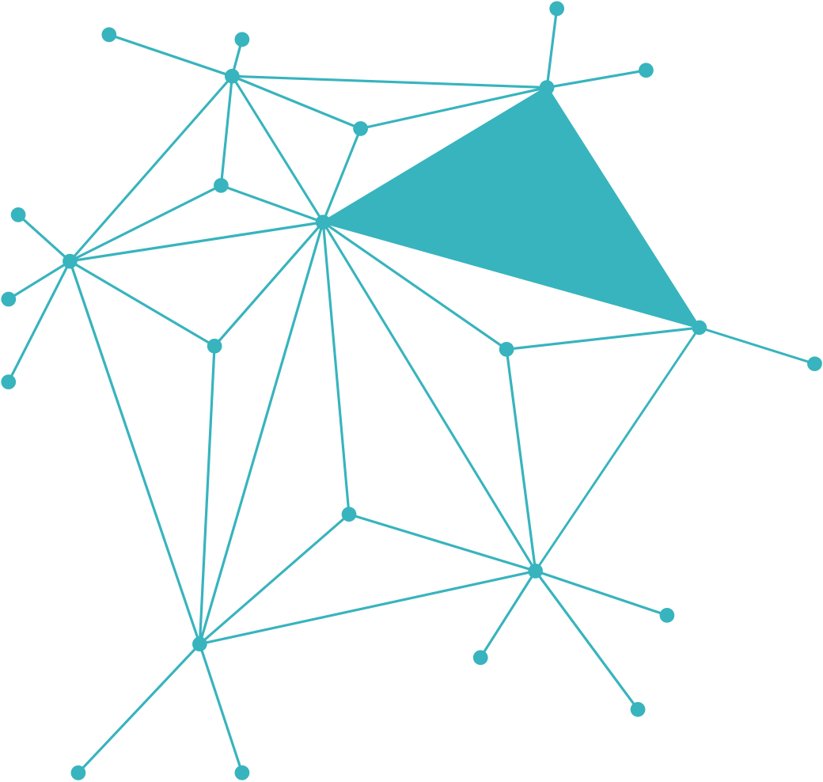

BROKEN AUTHENTICATION & SESSION MANAGEMENT (CWE-287)
Penetration Testing Report – Lucas G. Sipos

Slide 2
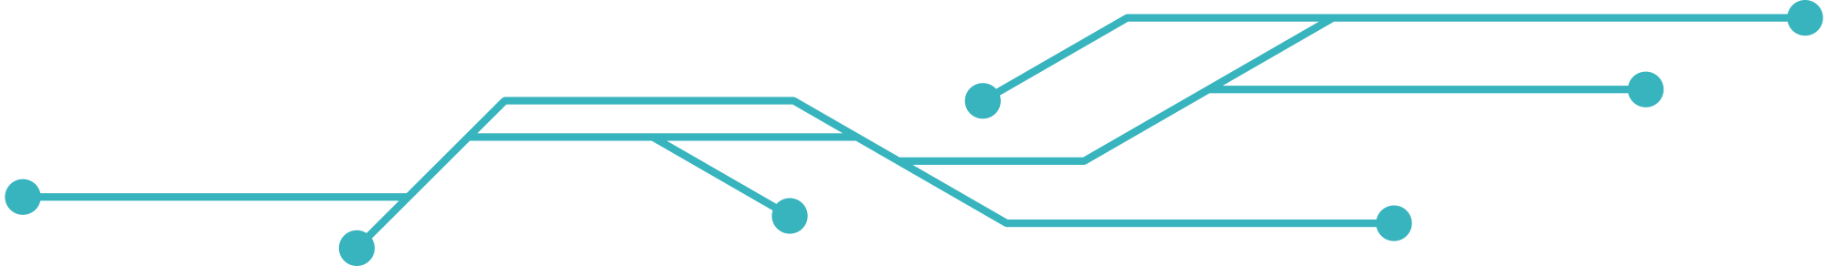



Broken Authentication & Session Management (CWE-287)
WHAT IS THE
Occurs when identity claims are not properly verified.
VULNERABILITY?
Allows attackers to impersonate users or gain admin access without proper credentials.

Slide 3
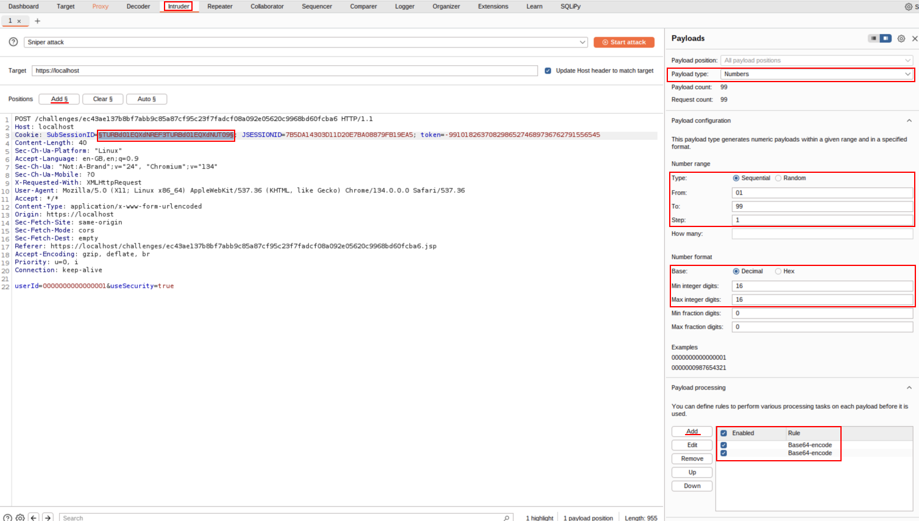
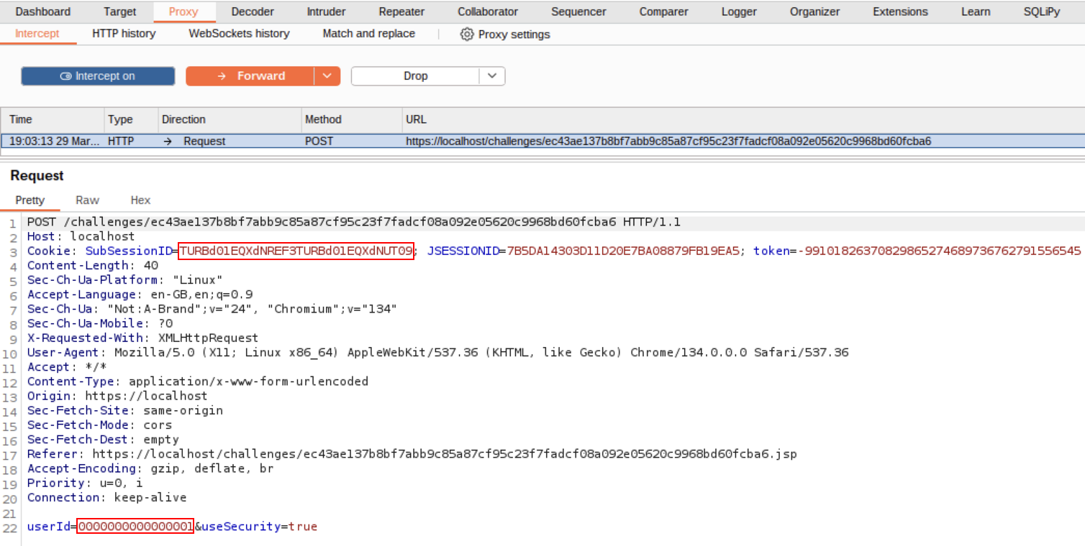
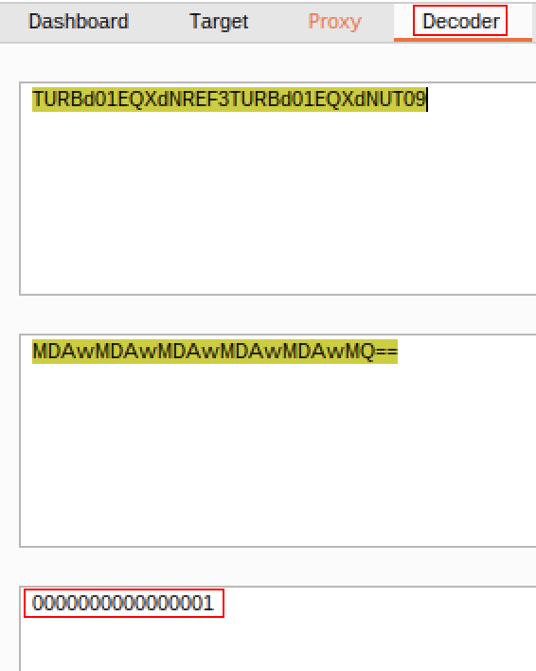
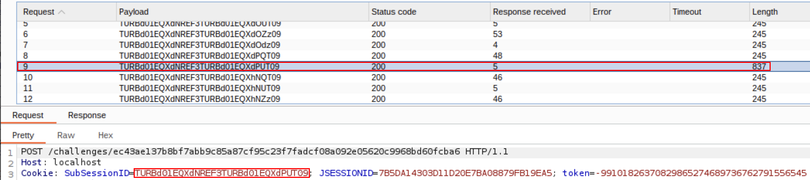
HOW TO
DO IT?
3
Payload Configuration
1
2
Intercept the request
2xDecode Base64
4
Irregular 9th request

Slide 4



RISKS &
IMPLICATIONS
AV
AC
PR
UI
Network
Low
None
None
S
C
I
A
Unchanged
High
High
None
CVSS SCORE (CRITICAL)
9.1/10

Slide 5
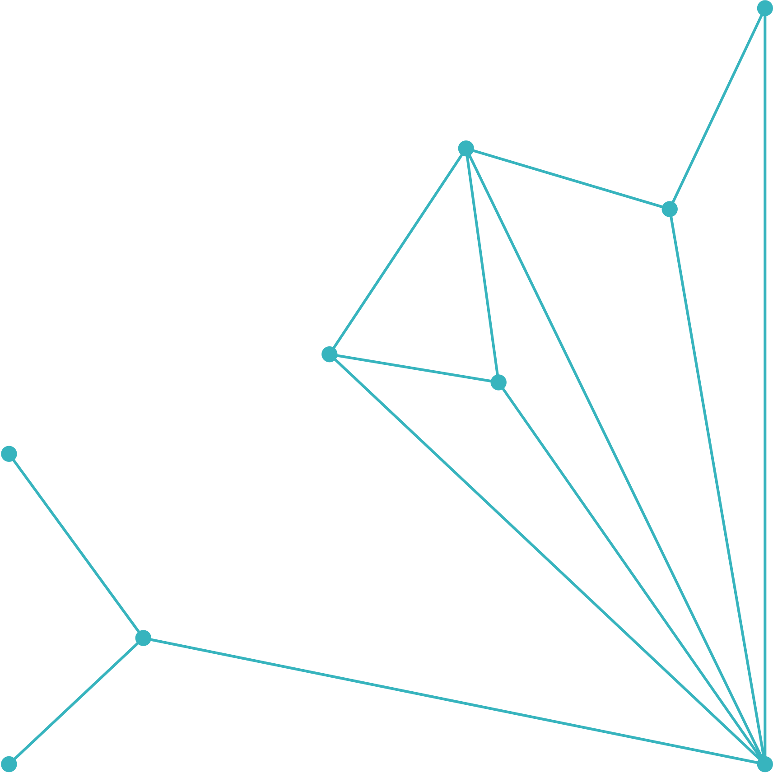
MITIGATION &
RECOMMENDATIONS
Regenerate session IDs after login
Use HttpOnly, Secure, SameSite cookies
Short session timeouts + IP/User-Agent binding
Avoid predictable encoding (e.g.: Base64)
Encrypt, salt & hash session tokens

Slide 6


THANK
YOU!
“Security is a continuous process — proactive measures today prevent breaches tomorrow.”

